Slide 1
Introducing the Physical Activity Guidelines for Americans, 2nd edition
Information adapted from the Physical Activity Guidelines for Americans, 2nd edition. Available at health.gov/PAGuidelines.
Notes:
This presentation gives an overview of what is in the second edition of the Physical Activity Guidelines for Americans and the Move Your Way communications campaign.

Slide 2
Background and Development Process

Slide 3
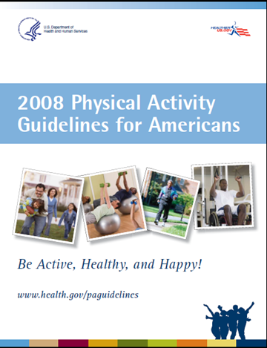
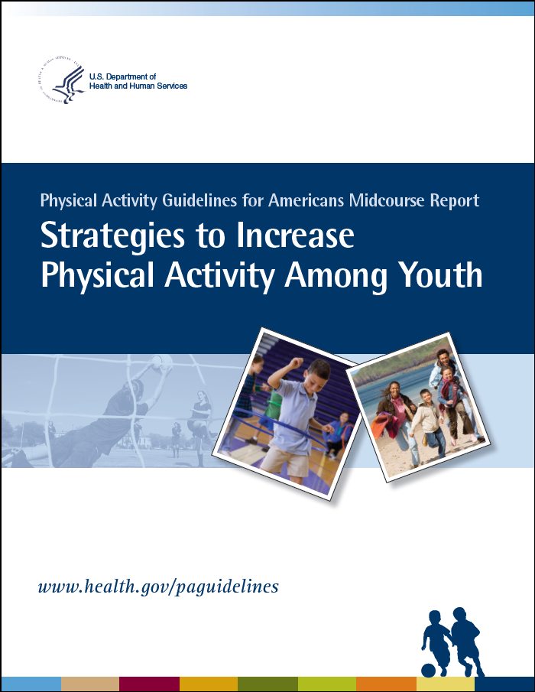

History of the Physical Activity Guidelines
2008
2013
2018

Slide 4
Development and Implementation of the Guidelines
Appointment of PAG Advisory Committee
Review of the current science
Development of Physical Activity Guidelines
Implemented in federal programs and initiatives
PAGAC Scientific Report
Notes:
The process to update the Physical Activity Guidelines begins with a review of the science base by an independent, external advisory committee.
The Committee was tasked to complete an extensive systematic literature review on the physical activity and health research.
The Committee’s systematic review was compiled into a scientific report and submitted to the HHS Secretary.
HHS used the Committee’s report, public comments, and agency comments to update the Guidelines.
After its release, the Guidelines will be incorporated in federal initiatives and resources like the Presidential Youth Fitness Program and the public health objectives in Healthy People.

Slide 5
Developing the Guidelines
Physical Activity Guidelines for Americans, 2nd edition
2018 PAG Advisory Committee Scientific Report
Public comment
Federal agency comment
Peer review
Notes:
HHS took the Committee’s Scientific report and used it, as well as comments from the public and federal agencies, to write the second edition of the Guidelines.
Additionally, the Physical Activity Guidelines for Americans undergoes peer review and clearance across the federal government prior to being approved and released by HHS.
The Guidelines informs physical activity programs, research, and initiatives across the federal government and at the state and local level.

Slide 6
Defining Terms

Slide 7
Types of Activity: Aerobic
Definition:
  Activity in which the body’s large muscles move in a rhythmic manner for a sustained period of time.
Examples:
  Brisk walking
  Running/jogging
  Swimming
  Bicycling
Aerobic activity has 3 components:
  Intensity, or how hard a person works to do the activity. The intensities most often studied are moderate (equivalent in effort to brisk walking) and vigorous (equivalent in effort to running or jogging);
  Frequency, or how often a person does aerobic activity; and
  Duration, or how long a person does an activity in any one session.

Slide 8
Types of Activity: Muscle-Strengthening
Definition:
  Physical activity, including exercise, that increases skeletal muscle strength, power, endurance, and mass.
Examples:
  Lifting weights
  Using resistance bands
  Bodyweight exercises
  Carrying heavy loads
  Heavy gardening
Muscle-Strengthening activity has 3 components:
  Intensity, or how much weight or force is used relative to how much a person is able to lift;
  Frequency, or how often a person does muscle-strengthening activity; and
  Sets and repetitions, or how many times a person does the muscle-strengthening activity, like lifting a weight or doing a push-up (comparable to duration for aerobic activity).

Slide 9
Types of Activity: Bone-Strengthening
Definition:
  Physical activity that produces an impact or tension force on the bones that promotes bone growth and strength.
  Also called weight-bearing or weight-loading activity
Note: bone-strengthening activities can also be aerobic and muscle strengthening.
Examples:
  Running
  Jumping Rope
  Lifting Weights

Slide 10
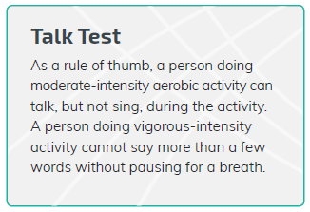
Defining Intensity
Moderate Intensity
Absolute scale: 3.0-5.9 METs
Relative scale: 5 or 6 on a scale of 0 to 10
Vigorous Intensity
Absolute scale: 6.0 or more METs
Relative scale: begins at a 7 or 8 on a scale of 0 to 10

Slide 11
What’s New In the Physical Activity Guidelines for Americans

Slide 12
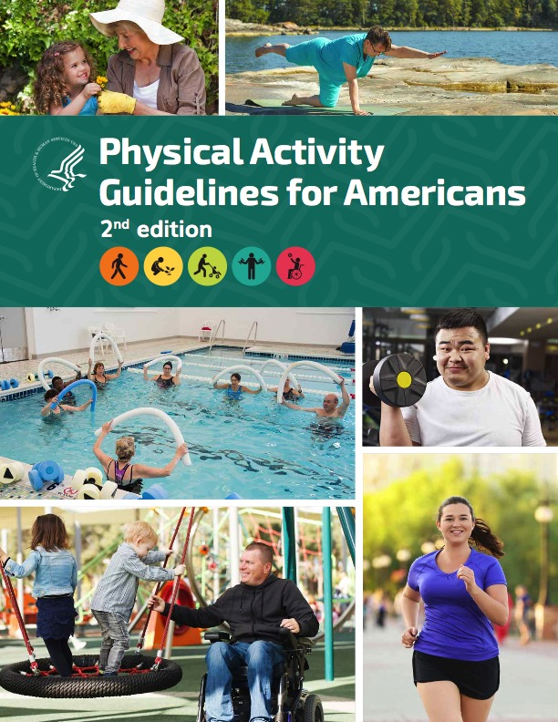
What’s New: Physical Activity Guidelines for Americans, 2nd edition
Expanded science base
New to this edition:
  Guidance for preschool-aged children (3-5 years)
  Discussion of sedentary behavior
  Removal of 10-minute bout length requirement
  Evidence for even more health benefits – including immediate effects
  Tested strategies for physical activity promotion

Slide 13
NEW: Guidelines for Children Ages 3 Through 5
Preschool-aged children (ages 3 through 5 years) should be physically active throughout the day to enhance growth and development.
Adult caregivers of preschool-aged children should encourage active play that includes a variety of activity types.
Notes:
For children ages 3 through 5, research shows that physical activity improves bone health and weight status. Regular physical activity also makes it less likely that obesity and related risk factors will develop and more likely that children remain healthy when they become adults.
Because health benefits specifically for children ages 3 through 5 are now established, HHS can issue guidelines for this age group.
Preschool-aged children should be encouraged to move and engage in active play as well as in structured activities, such as throwing games and bicycle or tricycle riding.
To strengthen bones, young children should do activities that involve hopping, skipping, jumping, and tumbling.
Although the specific amount of activity needed to improve bone health and avoid excess fat in young children is not well defined, a reasonable target may be 3 hours per day of activity of all intensities: light, moderate, or vigorous intensity. This is the average amount of activity observed among children of this age and is consistent with guidelines from Canada, the United Kingdom, and the Commonwealth of Australia.

Slide 14
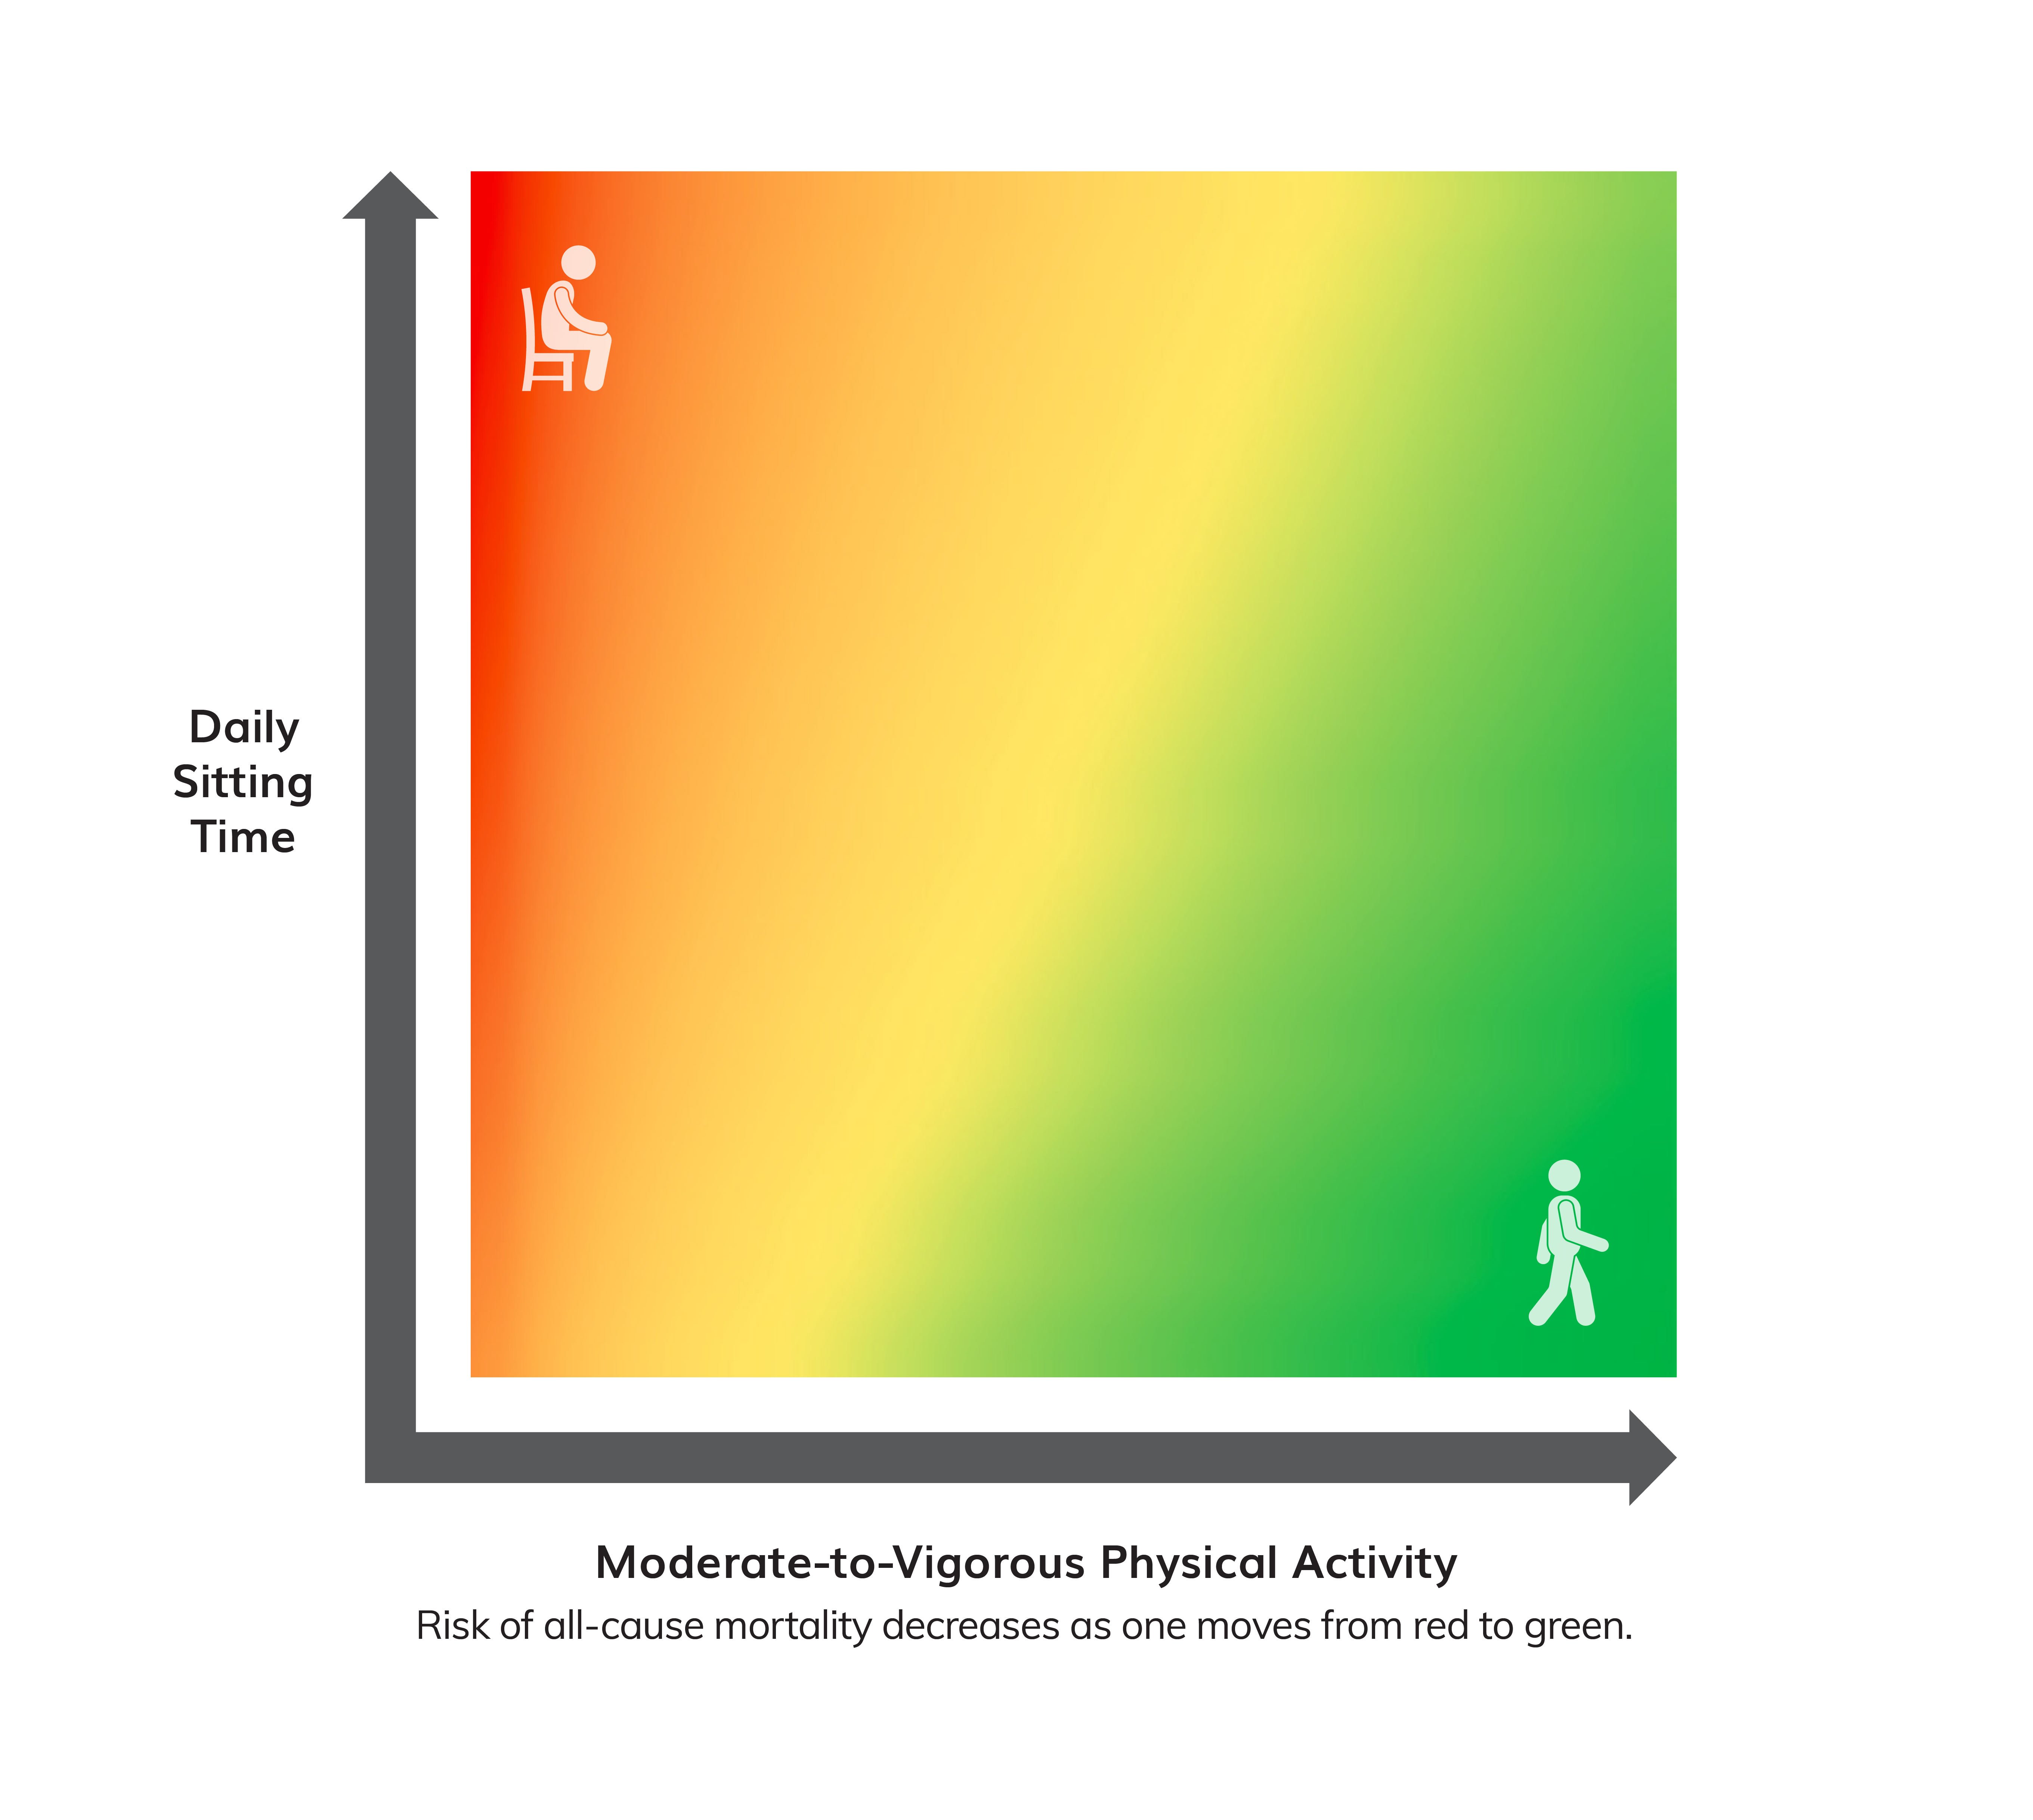
Move More and Sit Less
Relationship Among Moderate-to-Vigorous Physical Activity, Sitting Time, and Risk of All-Cause Mortality in Adults
Sedentary behavior increases risk of:
  All-cause mortality
  Cardiovascular disease mortality
  Cardiovascular disease
  Type 2 diabetes
  Colon, endometrial, and lung cancers
Notes:
The first key guideline for adults is to move more and sit less.
This recommendation is based on new evidence that shows a strong positive relationship between increased sedentary behavior and increased risk of all-cause mortality, heart disease, and high blood pressure.
All physical activity, especially moderate-to-vigorous activity, can help offset these risks.
For inactive adults, replacing sedentary behavior with light-intensity physical activity is likely to produce some health benefits.
Among all adults, replacing sedentary behavior with moderate- or vigorous-intensity physical activity may produce even greater benefits.
This figure, adapted from a meta-analysis of over 1 million people by Ekelund and colleagues, demonstrates the relationship between moderate-to-vigorous physical activity and the risk of all-cause mortality.
At the greatest time spent sitting (the top), the risk of all-cause mortality begins to decrease (color becomes orange) even with small additions of moderate-to-vigorous physical activity.
At the greatest volume of moderate-to-vigorous physical activity, the risk is low even for those who sit the most (upper right corner).
At the lowest volume of moderate-to-vigorous physical activity (the left of the figure), the risk of all-cause mortality increases as time spent sitting increases.
This suggests that for inactive adults, replacing sitting time with light-intensity physical activities reduces the risk of all-cause mortality.
Although the risk of all-cause mortality is reduced as the time spent in sedentary behavior is reduced, even adults who sit the least have an elevated risk if they perform no moderate-to-vigorous physical activity (lower left corner).

Slide 15
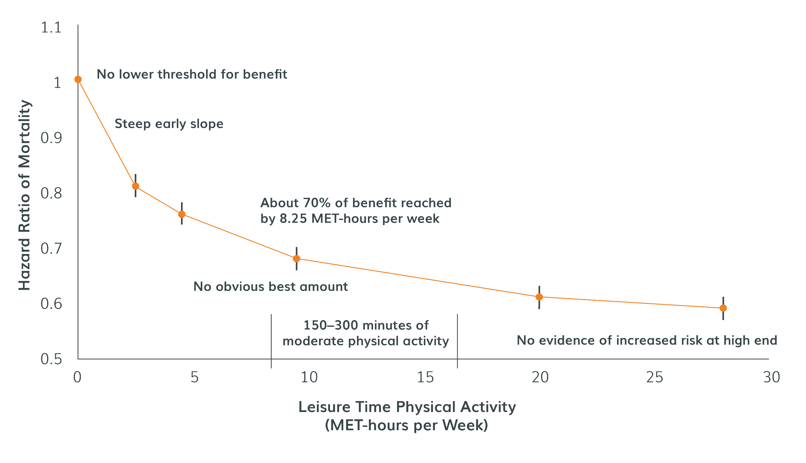
Any Activity Counts
Relationship of Moderate-to-Vigorous Physical Activity to All-Cause Mortality
No lower threshold for benefits from physical activity
Most benefits are attained with at least 150-300 minutes of moderate physical activity per week
Some health benefits are immediate
Notes:
Research now shows that any amount of physical activity has some health benefits. Americans can benefit from small amounts of moderate-to-vigorous physical activity throughout the day like taking the stairs and doing chores around the house.
Many of these benefits are immediate. For example, physical activity can reduce anxiety and blood pressure, and improve quality of sleep and insulin sensitivity.
The first edition of the PAG stated that only 10-minute bouts of physical activity counted toward meeting the Guidelines.
The second edition removes this requirement to encourage Americans to move more frequently throughout the day as they work toward meeting the Guidelines.
This figure demonstrates the benefits of even low amounts of moderate-to-vigorous physical activity.
As you can see, a large benefit occurs when a person moves from being inactive to being insufficiently active (defined as some moderate-to-vigorous physical activity, but not yet meeting the key guidelines target range).
The relative risk of all-cause mortality continues to decline as people become even more physically active.
Even at very high levels of physical activity (3 to 5 times the key guidelines), there is no evidence of increased risk.

Slide 16
Benefits of Physical Activity for Adults and Older Adults
Lower risk of all-cause mortality
Lower risk of cardiovascular disease mortality
Lower risk of cardiovascular disease (including heart disease and stroke)
Lower risk of hypertension
Lower risk of type 2 diabetes
Lower risk of adverse blood lipid profile
Lower risk of cancers of the bladder,* breast, colon, endometrium,* esophagus,* kidney,* lung,* and stomach*
Improved cognition*
Reduced risk of dementia (including Alzheimer’s disease)*
Improved quality of life
Reduced anxiety
Reduced risk of depression
Improved sleep
Slowed or reduced weight gain
Weight loss, particularly when combined with reduced calorie intake
Prevention of weight regain following initial weight loss
Improved bone health
Improved physical function
Lower risk of falls (older adults)
Lower risk of fall-related injuries (older adults)*
*New health benefit
Notes:
The evidence now indicates that meeting the recommendations in the Physical Activity Guidelines for Americans consistently over time can lead to even more health benefits for adults and older adults.
New research also strengthens the evidence for previously reported benefits. (new benefits in bold)
For adults, physical activity helps prevent eight types of cancer (bladder, breast, colon, endometrium, esophagus, kidney, stomach, and lung) and improve quality of life for cancer survivors; reduces the risk of dementia (including Alzheimer’s disease), all-cause mortality, heart disease, stroke, high blood pressure, type 2 diabetes, and depression; and improves bone health and physical function.
For older adults, physical activity also lowers the risk of falls and injuries from falls.
For pregnant women, physical activity reduces the risk of postpartum depression.
For all groups, physical activity helps maintain a healthy weight.

Slide 17
Benefits of Physical Activity for Youth
Improved bone health (ages 3 through 17 years)
Improved weight status (ages 3 through 17 years)
Improved cardiorespiratory and muscular fitness (ages 6 through 17 years)
Improved cardiometabolic health (ages 6 through 17 years)
Improved cognition (ages 6 to 13 years)
Reduced risk of depression (ages 6 to 13 years)
Notes:
New research also strengthens the evidence for previously reported benefits. (new benefits in bold)
For children and adolescents, physical activity can help improve cognition, bone health, fitness, and heart health, and reduce the risk of depression.

Slide 18
New Health Benefits
Short Term Benefits
Improve quality of life
Reduce anxiety
Reduce blood pressure
Improve insulin sensitivity
Improve sleep outcomes
Long Term Benefits
For youth, improve cognition
For adults, prevent 8 types of cancer (previously 2)
For adults, reduce risk of dementia, including Alzheimer’s disease
For older adults, lowers risk of injuries from falls
For pregnant women, reduces the risk of postpartum depression.
For all groups, reduces the risk of excessive weight gain
Disease Management
Decrease pain of osteoarthritis
Reduce disease progression for hypertension
Reduce disease progression for type 2 diabetes
Reduce symptoms of anxiety and depression
Improve cognition for those with dementia, multiple sclerosis, ADHD, and Parkinson’s disease

Slide 19
Brain Health
Outcome | Population | Benefit | Acute | Habitual
Cognition | Children ages 6 to 13 years | Improved cognition (performance on academic achievement tests, executive function, processing speed, memory) | • | •
Cognition | Adults | Reduced risk of dementia (including Alzheimer’s disease) |  | •
Cognition | Adults older than age 50 years | Improve cognition (executive function, attention memory, crystallized intelligence,* processing speed) |  | •
Quality of life | Adults | Improved quality of life |  | •
Notes:
New evidence on the relationship between physical activity and brain health has emerged since the last edition of the Guidelines.
Some effects can be seen immediately after a bout of moderate-to-vigorous physical activity, such as improved aspects of cognitive function in youth.
Regular physical activity improves aspects of cognition throughout the lifespan.
Additionally, physically active adults and older adults are likely to report having a better quality of life.

Slide 20
Brain Health, cont.
Outcome | Population | Benefit | Acute | Habitual
Depressed mood and depression | Children ages 6 to 17 years and adults | Reduced risk of depression Reduced depressed mood |  | •
Anxiety | Adults | Reduced short-term feeling of anxiety (state anxiety) | •
Anxiety | Adults | Reduced long-term feeling and signs of anxiety disorders |  | •
Sleep | Adults | Improved sleep outcomes (increased sleep efficiency, sleep quality, deep sleep; reduced daytime sleepiness frequency of use of medication to aid sleep |  | •
Sleep | Adults | Improved sleep outcomes that increase with duration of acute episode | •
Notes:
Anxiety and anxiety disorders are the most prevalent mental disorders.
Short-term feelings of anxiety are reduced immediately following a bout of moderate-to-vigorous physical activity, and regular physical activity has positive effects on long-term feelings of anxiety.
Habitual physical activity also reduces symptoms of diagnosed anxiety and depression in adults, and can reduce the risk of developing depression.
Additionally, physical activity can help improve sleep outcomes. It doesn’t matter when activity is performed. Benefits are similar for physical activity performed more than 8 hours before bedtime, 3 to 8 hours before, and less than 3 hours before bedtime.

Slide 21
What Works to Increase Physical Activity?
For Individuals or
Small Groups
For Communities
Guidance from peers or professionals
Point of decision prompts
Support from others
Technology
School policies and practices
Access to indoor or outdoor recreation facilities or outlets
Community-wide campaigns
Community design

Slide 22
Key Guidelines

Slide 23
Key Guidelines for Preschool-Aged Children
Preschool-aged children (ages 3 through 5 years) should be physically active throughout the day to enhance growth and development.
Adult caregivers of preschool-aged children should encourage active play that includes a variety of activity types.
Notes:
For children ages 3 through 5, research now shows that physical activity improves bone health and weight status. Regular physical activity also makes it less likely that obesity and related risk factors will develop and more likely that children remain healthy when they become adults.
Because health benefits specifically for children ages 3 through 5 are now established, HHS can issue guidelines for this age group.
Preschool-aged children should be encouraged to move and engage in active play as well as in structured activities, such as throwing games and bicycle or tricycle riding.
To strengthen bones, young children should do activities that involve hopping, skipping, jumping, and tumbling.
Although the specific amount of activity needed to improve bone health and avoid excess fat in young children is not well defined, a reasonable target may be 3 hours per day of activity of all intensities: light, moderate, or vigorous intensity. This is the average amount of activity observed among children of this age and is consistent with guidelines from Canada, the United Kingdom, and the Commonwealth of Australia.

Slide 24
Key Guidelines for School-Aged Children and Adolescents
It is important to provide young people opportunities and encouragement to participate in physical activities that are appropriate for their age, that are enjoyable, and that offer variety.
Children and adolescents ages 6 through 17 years should do 60 minutes (1 hour) or more of moderate-to-vigorous physical activity daily:
  Aerobic: Most of the 60 minutes or more per day should be either moderate- or vigorous-intensity aerobic physical activity and should include vigorous-intensity physical activity on at least 3 days a week.
  Muscle-strengthening: As part of their 60 minutes or more of daily physical activity, children and adolescents should include muscle-strengthening physical activity on at least 3 days a week.
  Bone-strengthening: As part of their 60 minutes or more of daily physical activity, children and adolescents should include bone-strengthening physical activity on at least 3 days a week.
Information adapted from the Physical Activity Guidelines for Americans, 2nd edition. Available at health.gov/PAGuidelines.
Notes:
The key guidelines for children and adolescents ages 6-17 is unchanged from 2008.

Slide 25
Key Guidelines for Adults
Adults should move more and sit less throughout the day. Some physical activity is better than none. Adults who sit less and do any amount of moderate-to-vigorous physical activity gain some health benefits.
For substantial health benefits, adults should do at least 150 minutes (2 hours and 30 minutes) to 300 minutes (5 hours) a week of moderate-intensity, or 75 minutes (1 hour and 15 minutes) to 150 minutes (2 hours and 30 minutes) a week of vigorous-intensity aerobic physical activity, or an equivalent combination of moderate- and vigorous-intensity aerobic activity. Preferably, aerobic activity should be spread throughout the week.
Additional health benefits are gained by engaging in physical activity beyond the equivalent of 300 minutes (5 hours) of moderate-intensity physical activity a week.
Adults should also do muscle-strengthening activities of moderate or greater intensity and that involve all major muscle groups on 2 or more days a week, as these activities provide additional health benefits.
Information adapted from the Physical Activity Guidelines for Americans, 2nd edition. Available at health.gov/PAGuidelines.
Notes:
The quantitative key guidelines for adults are unchanged from 2008.

Slide 26
Key Guidelines for Older Adults
The key guidelines for adults also apply to older adults. In addition, the following key
guidelines are just for older adults:
  As part of their weekly physical activity, older adults should do multicomponent physical activity that includes balance training as well as aerobic and muscle-strengthening activities.
  Older adults should determine their level of effort for physical activity relative to their level
  of fitness.
  Older adults with chronic conditions should understand whether and how their conditions affect their ability to do regular physical activity safely.
  When older adults cannot do 150 minutes of moderate-intensity aerobic activity a week because of chronic conditions, they should be as physically active as their abilities and conditions allow.
Information adapted from the Physical Activity Guidelines for Americans, 2nd edition. Available at health.gov/PAGuidelines.
Notes:
The key guidelines for older adults are the same as those for adults, but there is some additional guidance just for older adults.
One change is the recommendation to do multicomponent physical activity, which includes balance training, aerobic, and muscle-strengthening activities.

Slide 27
Key Guidelines for Adults with Chronic Health Conditions and Adults with Disabilities
Adults with chronic conditions or disabilities, who are able, should do at least 150 minutes (2 hours and 30 minutes) to 300 minutes (5 hours) a week of moderate-intensity, or 75 minutes (1 hour and 15 minutes) to 150 minutes (2 hours and 30 minutes) a week of vigorous-intensity aerobic physical activity, or an equivalent combination of moderate- and vigorous-intensity aerobic activity. Preferably, aerobic activity should be spread throughout the week.
Adults with chronic conditions or disabilities, who are able, should also do muscle-strengthening activities of moderate or greater intensity and that involve all major muscle groups on 2 or more days a week, as these activities provide additional health benefits.
Information adapted from the Physical Activity Guidelines for Americans, 2nd edition. Available at health.gov/PAGuidelines.

Slide 28
Key Guidelines for Adults with Chronic Health Conditions and Adults with Disabilities, continued
When adults with chronic conditions or disabilities are not able to meet the above key guidelines, they should engage in regular physical activity according to their abilities and should avoid inactivity.
Adults with chronic conditions or symptoms should be under the care of a health care provider. People with chronic conditions can consult a health care professional or physical activity specialist about the types and amounts of activity appropriate for their abilities and chronic conditions.
Information adapted from the Physical Activity Guidelines for Americans, 2nd edition. Available at health.gov/PAGuidelines.

Slide 29
Key Guidelines for Women During Pregnancy and the Postpartum Period
Women should do at least 150 minutes (2 hours and 30 minutes) of moderate-intensity aerobic activity a week during pregnancy and the postpartum period. Preferably, aerobic activity should be spread throughout the week.
Women who habitually engaged in vigorous-intensity aerobic activity or who were physically active before pregnancy can continue these activities during pregnancy and the postpartum period.
Women who are pregnant should be under the care of a health care provider who can monitor the progress of the pregnancy. Women who are pregnant can consult their health care provider about whether or how to adjust their physical activity during pregnancy and after the baby is born.
Information adapted from the Physical Activity Guidelines for Americans, 2nd edition. Available at health.gov/PAGuidelines.

Slide 30
Key Guidelines for Safe Physical Activity
To do physical activity safely and reduce risk of injuries and other adverse events, people should:
  Understand the risks, yet be confident that physical activity can be safe for almost everyone.
  Choose types of physical activity that are appropriate for their current fitness level and health goals, because some activities are safer than others.
  Increase physical activity gradually over time to meet key guidelines or health goals. Inactive people should “start low and go slow” by starting with lower-intensity activities and gradually increasing how often and how long activities are done.
  Protect themselves by using appropriate gear and sports equipment, choosing safe environments, following rules and policies, and making sensible choices about when, where, and how to be active.
  Be under the care of a health care provider if they have chronic conditions or symptoms. People with chronic conditions and symptoms can consult a health care professional or physical activity specialist about the types and amounts of activity appropriate for them.

Slide 31
Promoting Physical Activity

Slide 32
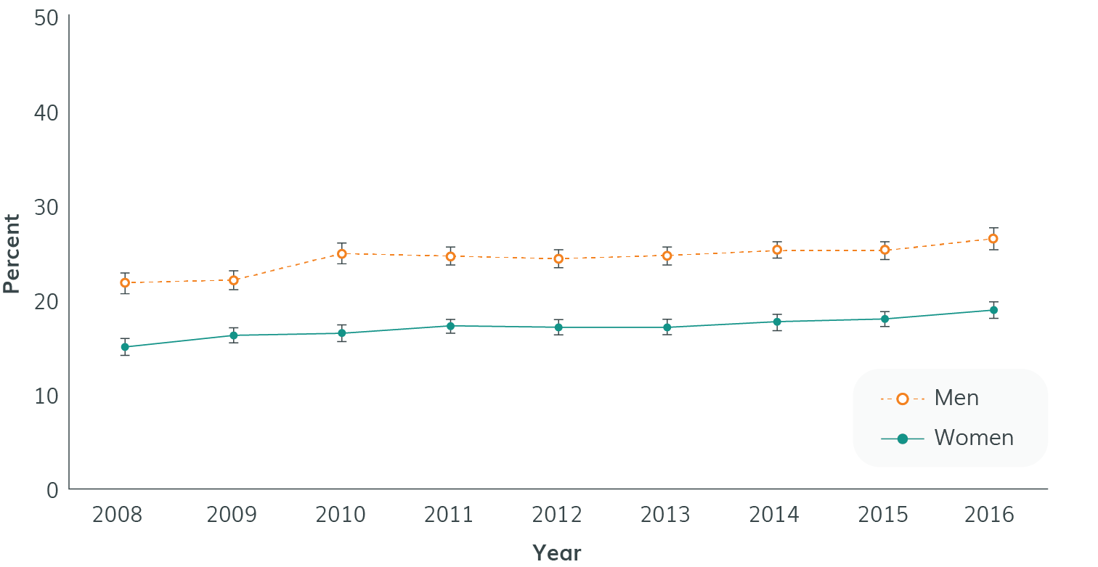
Why We Need to Promote Physical Activity
Costs of Inadequate Physical Activity*
  $117 billion dollars in annual health care costs
  10 percent of premature mortality
*Defined as not meeting the key guidelines for adults
Percentage of U.S. Adults Ages 18 Years or Older Who Met the Aerobic and Muscle-Strengthening Guidelines, 2008–2016
Notes:
In the United States, nearly $117 billion dollars in annual healthcare costs and 10% of all premature mortality stem from failure to meet levels of aerobic physical activity recommended in the Physical Activity Guidelines for Americans. In fact, only 26% of men and 19% of women meet these recommendations despite the fact that they are readily achievable by most Americans.
By simply meeting these key guidelines, billions of dollars and hundreds of thousands of lives could be saved, and millions more Americans could experience improved quality of life.
As shown in the figure, there has been progress in increasing the activity level of adults. In fact, the Healthy People 2020 target for this objective has been exceeded. However, there is still a lot of room for improvement.

Slide 33
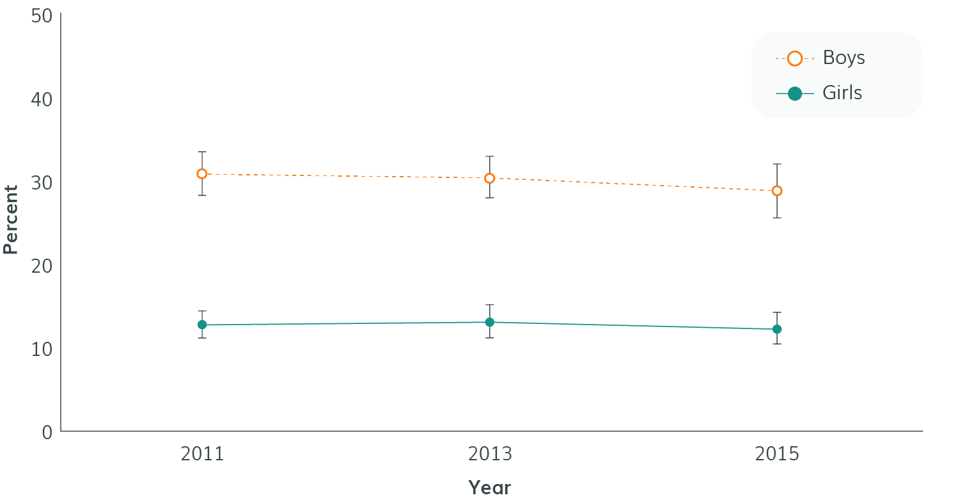
Why We Need to Promote Physical Activity, cont.
Childhood obesity rates have tripled since the 1970s
Obesity disqualifies nearly one-third of American youth, ages 17 to 24, from military service
Percentage of U.S. High School Students Who Met the Aerobic Physical Activity and Muscle-Strengthening Guidelines, 2011–2015
Notes:
Only about 20 percent of adolescents report sufficient activity to meet the relevant aerobic and muscle-strengthening guidelines, and the data on this slide from the Youth Risk Behavior Surveillance System shows that this number is declining, not rising.
Physical activity fosters normal growth and development. Further efforts to increase the activity level of youth are critical as childhood obesity rates have more than tripled since the 1970s.
Lack of physical activity is also a threat to national security because obesity disqualifies nearly one third of American youth, ages 17 to 24 years, from military service.

Slide 34
Everyone Has a Role to Play
Personalize the benefits of physical activity
Families and Caregivers
Start early
Develop knowledge and skills to attain goals
Set personal goals for physical activity
Provide time for both structured and unstructured physical activity during school and outside of school
Provide youth with positive feedback and good role models
Help young people learn skills required to do physical activity safely
Promote activities that set the basis for a lifetime of activity
Individuals

Slide 35
Take Action: Strategies to Promote Physical Activity
Healthcare
Business and Industry
Community Recreation, Fitness, and Parks
Education
Faith-Based Settings
Mass Media
Public Health
Sports
Notes:
The second edition of the Physical Activity Guidelines for Americans includes evidence-based strategies to help Americans become more physically active.
Many of these strategies are sector-based.
For example, health care professionals can tailor messages about physical activity to the patient’s specific health needs and socioeconomic limitations, connect patients to programs and events within the community, including those sponsored by faith-based organizations, and prescribe exercise to their patients.
Those in public health can support work at the community level to provide opportunities for safe physical activity. They can coordinate activities among sectors and disseminate messages about the importance of physical activity to the public.
More information about the role of these sectors is in the National Physical Activity Plan which includes objectives and strategies for each of the nine sectors highlighted. Note: the National Physical Activity Plan is a product of the National Physical Activity Plan Alliance. The Plan can be accessed at http://www.physicalactivityplan.org/index.html

Slide 36

Promoting the Guidelines:
The Move Your Way Campaign

Slide 37
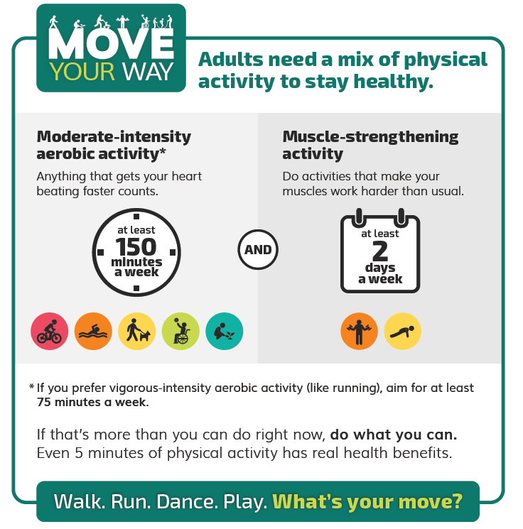
Move Your Way Campaign
Vision: Consumer-focused campaign to promote physical activity recommendations in the second edition of the Physical Activity Guidelines
Purpose:
  Raise awareness of recommendations
  Change behavior among consumers
Target audiences: physical activity contemplators, or those who are not yet meeting the recommendations in the Physical Activity Guidelines and health professionals (as conduit to consumers)

Slide 38
Move Your Way Audience Research
Environmental scan
Fitness and exercise companies
Focus groups
Organizations that promote physical activity
Government physical activity campaigns
Non-government physical activity campaigns
Adult physical activity contemplators (12 in-person groups, 6 with parents, 3 in Spanish, n=95)
Health professionals (3 virtual groups, n=19)
Online survey (n=2050)
Level of familiarity with PAG recommendations
Attitudes around physical activity
Behavioral intention around physical activity
Promising channels for message delivery
Icon and message testing
Consumers (9 in-person groups, 2 in Spanish, n=72)
Health professionals (2 virtual groups, n=9)
Stakeholders (9 in-depth interviews)
Children ages 8-12 (n=25)
Teens ages 13-16 (n=31)
Parents of children ages 3-6 (n=28)
Notes:
HHS completed an extensive amount of audience research and user testing to inform the campaign. On this slide, you can see a summary of these activities, which included research and testing with adults, parents, children, teenagers, health professionals, and physical activity stakeholders.

Slide 39
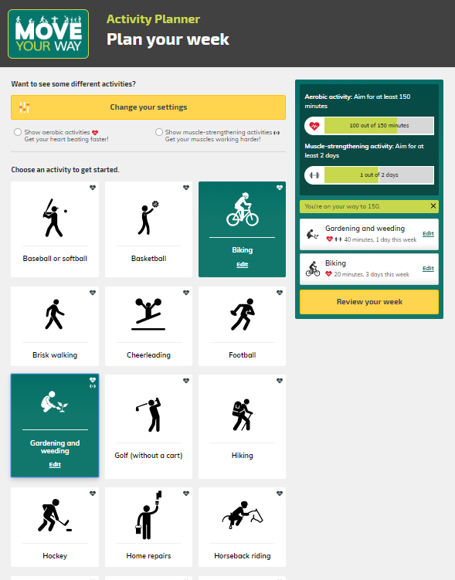
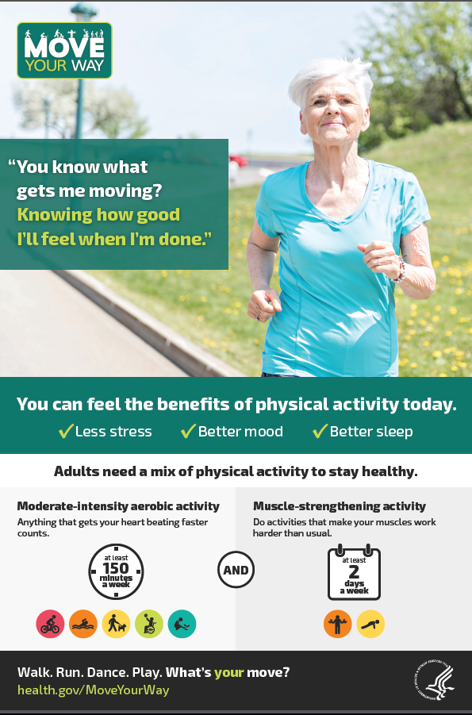
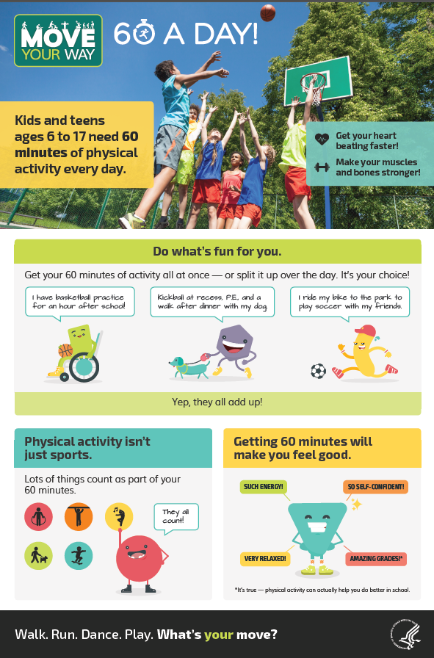


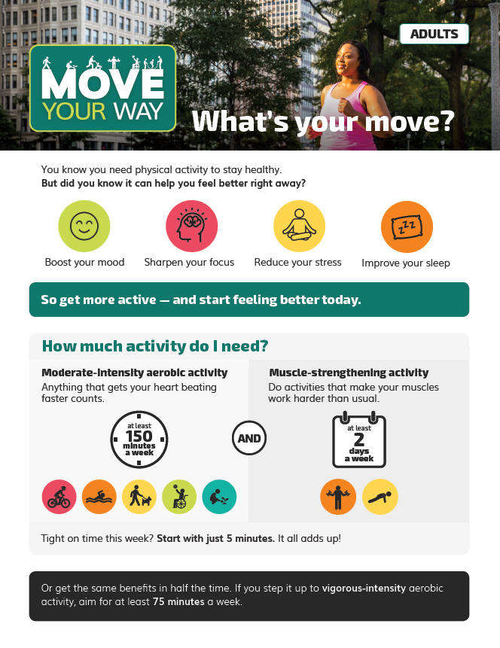
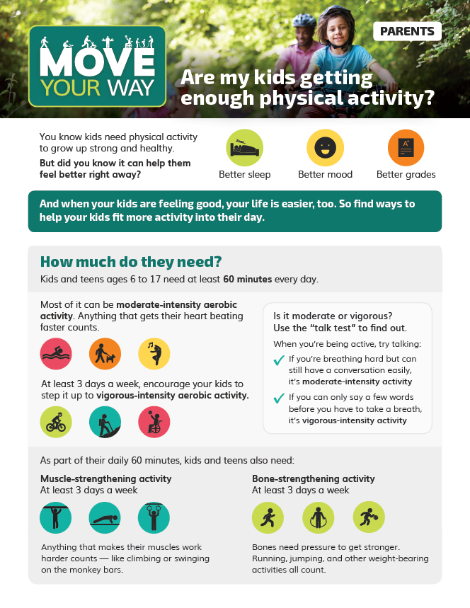

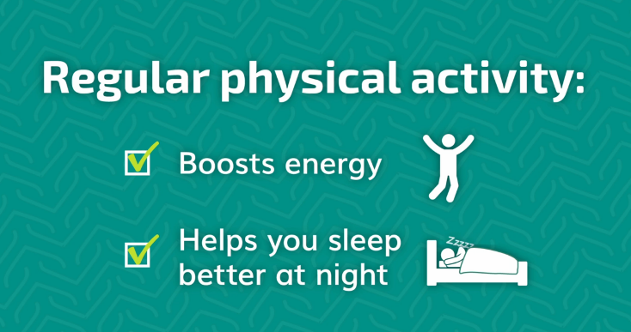
Move Your Way Campaign Resources
Interactive tools
Posters and factsheets
Series of videos
Notes:
HHS used audience research to inform a suite of over 40 resources that are available in English and Spanish at health.gov. Just a few of these resources are pictured on the slide.
These resources include:
A weekly activity planner for adults that allows users to develop a personalized plan for meeting the recommendations based on their preferences,
An interactive infographic for parents to assess opportunities for their school-aged children to get active throughout the day,
A series of five posters and five factsheets for adults, older adults, parents, children, and health professionals, and
A series of four videos with tips for adults and parents to fit more physical activity into the day.
A toolkit for promoting the Move Your Way campaign through social media

Slide 40
Move Your Way Web Badges and Widget
Content can be added to your digital platform and HHS will update the web badge and widget content automatically.
Move Your Way Activity Planner web badge links people to the HHS interactive tool to help them build a personalized weekly activity plan.
Move Your Way Activity Planner widget lets people start personalizing their weekly activity plan right on your website. Then it links them to the HHS interactive tool to continue building their plan.
Move Your Way Parent Interactive Graphic web badge links parents to the HHS interactive infographic to see how their kids can get 60 minutes of activity a day.

Slide 41

Find Out More
For health professionals:
https://health.gov/PAGuidelines
For consumers: https://health.gov/MoveYourWay/

